Slide 1
Basic Income: A brief history of the idea
A presentation for BIEN’s clarification of the Basic Income definition working group, based on a paper for a conference at Braunschweig, 3rd and 4th March 2022
Malcolm Torry

Slide 2
BIEN definition
A Basic Income is a periodic cash payment unconditionally delivered to all on an individual basis, without means-test or work requirement.
Variants:
‘to all’?
‘periodic’?
How much?
‘Universal’ and ‘unconditional’

Slide 3
Early history
Thomas More?
Charles Fourier?
Thomas Paine?
Thomas Spence
The first Basic Income proposal
A quarterly payment to every individual

Slide 4
The State Bonus League, 1918
A State Bonus
Every individual, all the time, should receive from a central fund some small allowance in money which would be just sufficient to maintain life and liberty if all else failed.
That as everyone is to get a share from this central fund, so everyone who has any income at all should contribute a share each in proportion to his capacity. … (Milner and Milner, 1918: 7)
Weekly, for ‘every man, every woman, and every child’ (Milner and Milner, 1918: 7)
Five shillings (£0.25) per week, equivalent to £15 per week today (Bank of England, 2022).

Slide 5
The modern debate in the UK
James Meade’s 1935 ‘social dividend’: a Basic Income
Juliet Rhys Williams, 1943: almost a Basic Income
21 shillings and 19 shillings: £1.05 and £0.95, translating as £49 and £45 in 2020 (Bank of England, 2022)
Brandon Rhys Williams/Hermione (Mimi) Parker
£17 per week, would have translated to £61 per week in 2020 (Bank of England, 2022
The Basic Income Research Group/Citizen’s Basic Income Trust, 1984
‘sufficient to meet basic needs’, but not from 1988 onwards
Feasibility means only minimal losses for low-income households

Slide 6
The UK debate
Proposals mainly conform to the BIEN definition:
A Basic Income is a periodic cash payment unconditionally delivered to all on an individual basis, without means-test or work requirement.
Regular weekly payments to all
‘Subsistence level’ not feasible
An unconditional payment below subsistence level is a Basic Income

Slide 7
Continental Europe
Philippe Van Parijs
1986, the first BIEN congress: no specification of the amount in the terminological note
1986, van der Veen and Van Parijs: ‘suppose that’ a ‘universal grant’ might be payable that would satisfy ‘fundamental needs’
1995, Van Parijs: ‘at the highest sustainable level’
A Basic Income is a regular payment to all
Diversity in relation to the amount —

Slide 8
The 2017 survey
some affiliated organisations did not mention the amount, suggesting that the amount to be paid is not integral to the definition;
some said that a democratic process would be used to decide the amount;
one mentioned a particular amount (South Africa);
and some offered a description of the kind of life that the Basic Income would be expected to fund (‘subsistence’, ‘dignity’, ‘participation’, ‘poverty line’) in relation to the national context, but without specifying the relevant level of Basic Income

Slide 9
Alternatives to Basic Income
Minimum Income Guarantee
US and Canadian experiments
Ontario (household-based and income-tested benefit)
Participation Income
Negative Income Tax
Tax Credits
US Earned Income Tax Credit
Basic Income Guarantee
Alternatives, not variants
The importance of definitions
The importance of clarity
The Alaskan Permanent Fund Dividend?

Slide 10
BIEN’s published clarifications
Periodic—It is paid at regular intervals (for example every month), not as a one-off grant.
Cash payment—It is paid in an appropriate medium of exchange, allowing those who receive it to decide what they spend it on. It is not, therefore, paid either in kind (such as food or services) or in vouchers dedicated to a specific use.
Individual—It is paid on an individual basis—and not, for instance, to households.
Universal—It is paid to all, without means test.
Unconditional—It is paid without a requirement to work or to demonstrate willingness-to-work. (Basic Income Earth Network, 2022)

Slide 11
Discussion continues
about
gaps in BIEN’s definition and clarifications
the level at which a Basic Income would be paid
BIEN’s ‘Clarification of the Basic Income Definition’ working group
‘uniform’
‘non-seizeable’
Basic Income a human right?
‘Is a penny a month a Basic Income?’ (Toru Yamamori)
The avoidance of net disposable income losses among low income households
Microsimulation

Slide 12
A new complexity
If an employer claims a standard amount from the government once a month for each employee,
adds the standard amount to the net amount paid to the employee after tax has been deducted from earned income,
and then lists that standard amount separately on the pay statement,
has a Basic Income been paid?

Slide 13
‘To all’?
National or state-level Basic Incomes
Eurodividend
Residents with different statuses: Asylum seekers? Visitors?
Local polities
A UK working party in 2017
Anyone living in the UK with the right to do so indefinitely, and refugees with a defined number of years of legal residence, would receive … Basic Incomes if they would be defined as resident in the UK by Her Majesty’s Revenue and Customs, and they have been resident in the UK for a minimum residency period. A national of another country which had implemented a … Basic Income would be entitled to receive an individual … Basic Income on arrival in the UK if their country gave the same right to UK nationals. (Citizen’s Basic Income Trust, 2018)

Slide 14
The debate must continue
Consensus about definitions
Clarity
Variants should be debated
Legitimate debate about BIEN’s published definition and clarifications

Slide 15
A personal suggestion for amended clarifications
A Basic Income is a periodic cash payment unconditionally delivered to all on an individual basis, without means-test or work requirement.
Here are ten characteristics of Basic Income
Periodic—It is paid at regular intervals (for example once a week or once a month).
Cash payment—It is paid in an appropriate medium of exchange, allowing those who receive it to decide what they spend it on. It is not, therefore, paid either in kind (such as food or services) or in vouchers dedicated to a specific use.
Individual—It is paid on an individual basis—and not, for instance, to households, or on the basis of household structure.

Slide 16
A personal suggestion for amended clarifications (continued)
Substantial—The Basic Income should be paid at a level that provides a significant secure income platform, but not necessarily at subsistence level somehow defined.
Universal—The Basic Income is paid to all legal residents within the national or regional boundaries within which the Basic Income is implemented.
Unconditional—The Basic Income is paid without a requirement to work or to demonstrate willingness-to-work. It is paid without an income test, without a means test, and without any other condition being applied, except that different age groups might receive different amounts.

Slide 17
A personal suggestion for amended clarifications (continued)
Uniform—The Basic Income is paid at the same rate, every week or every month, to everyone of the same age. The amount for each age group might be uprated once a year.
Non-seizeable—no court or government or other agency should be able to claim the whole or part of any individual’s Basic Income for the payment of fines, for the settling of civil claims, or for any other reason.
Funding method—A variety of methods for funding a Basic Income might be feasible. The definition of feasible should always include the avoidance of household disposable income losses for low-income households.

Slide 18
A personal suggestion for amended clarifications (continued)
Administration of the payment—payment will normally be as a separate amount received weekly or monthly into a bank account or in cash. A government might arrange for employers to administer the Basic Income for their employees, in which case the employee will receive earned income, less tax, and plus the Basic Income, as a single payment. This is permitted, as long as at least the amount of the Basic Income is received securely every week or every month, with no breaks in the regular receipt of at least that amount.

Slide 19
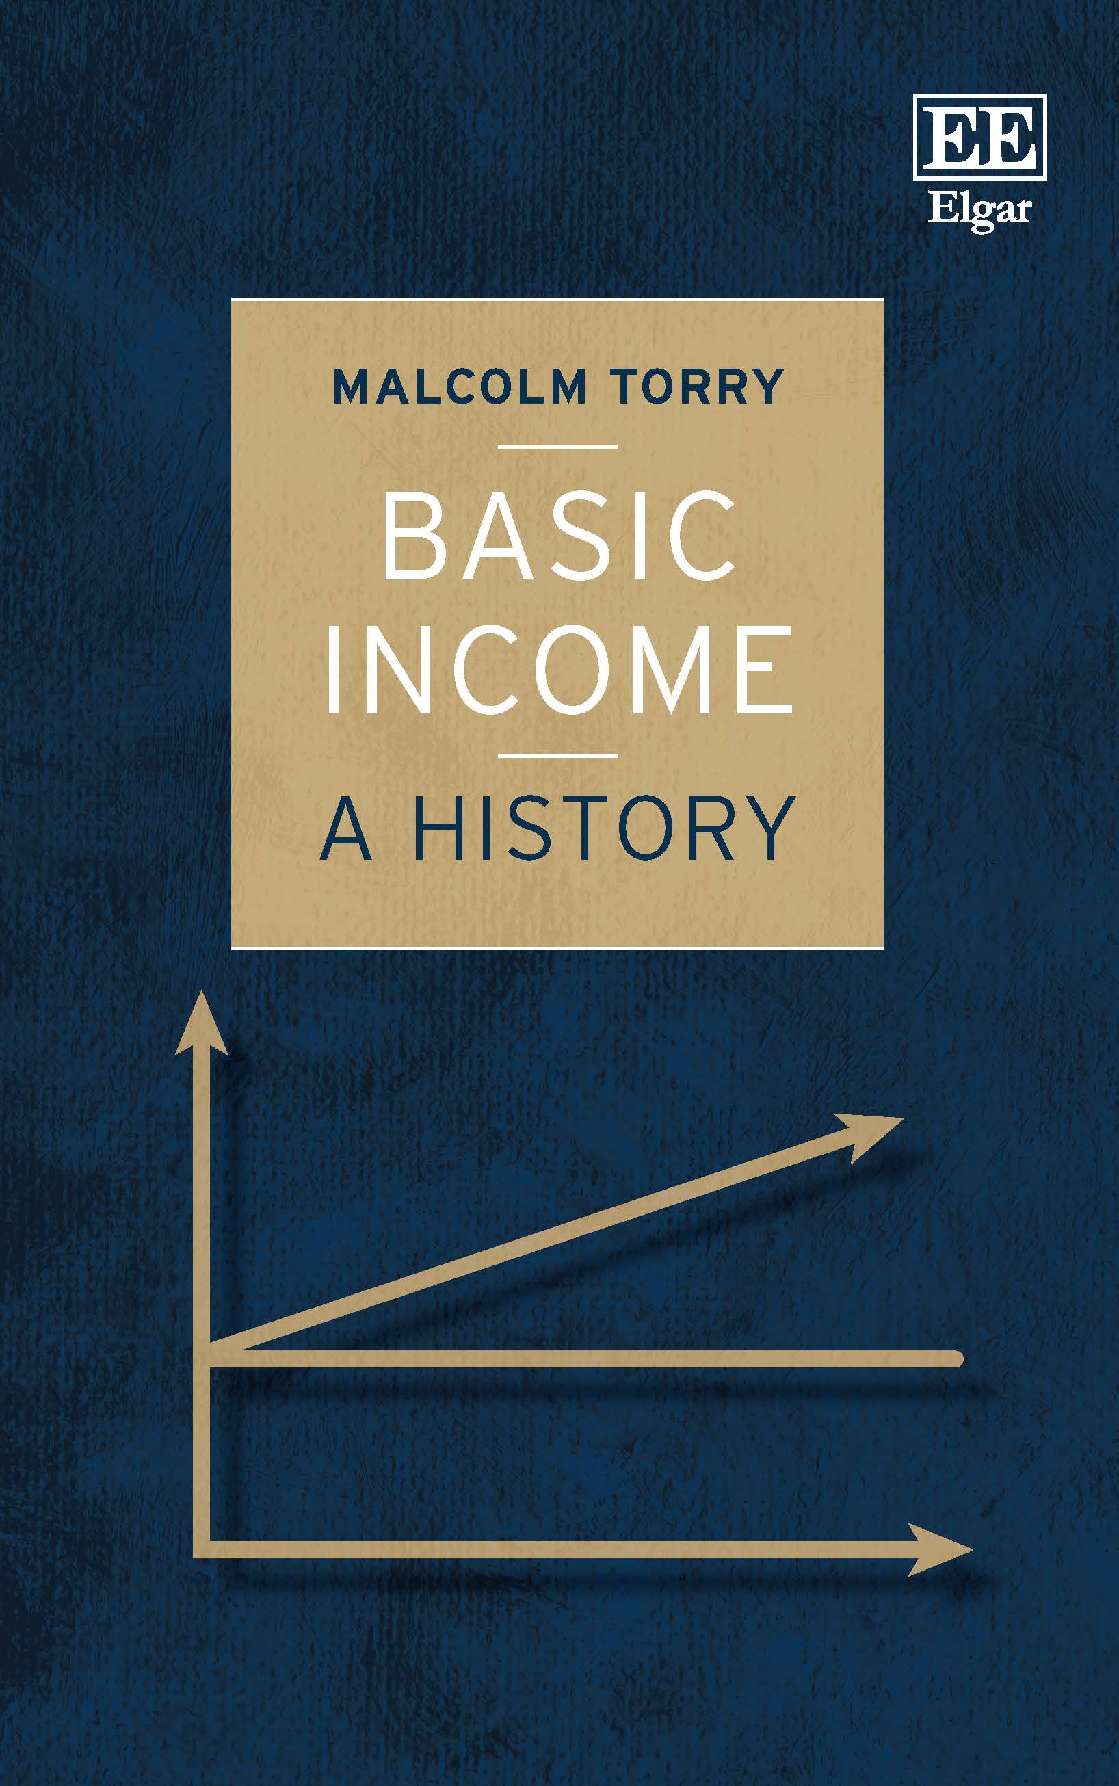

Slide 20
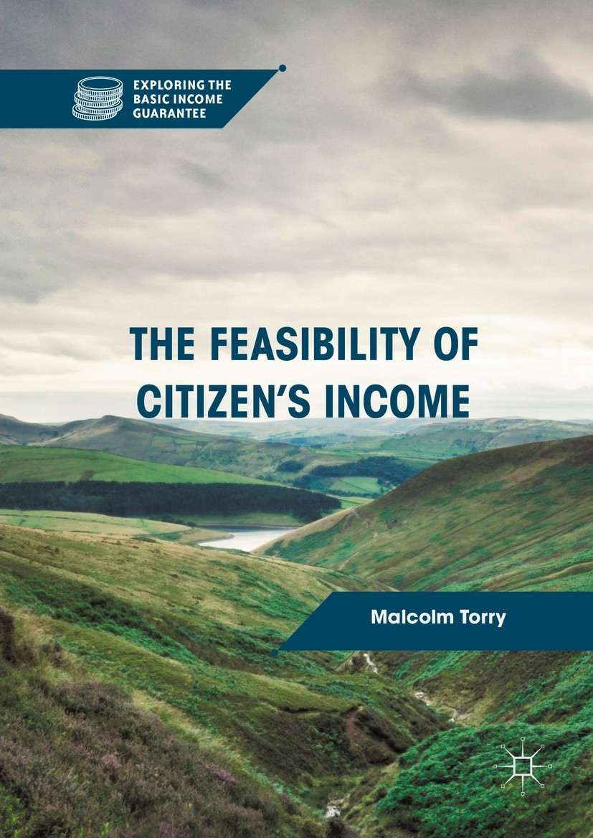

Slide 21
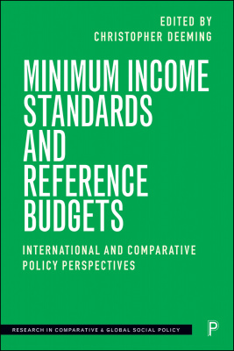

Slide 22
CEMPA working paper 7/22
Two feasible Basic Income schemes for the UK, and a feasible pilot project for Scotland
May 2022
https://www.microsimulation.ac.uk/publications/publication-547284/

Slide 23
Additional books, further information, and links to the publishers’ websites, can be found here:
https://torry.org.uk/basic-income

